Slide 1
Why Car Accidents Happen:
What Data Can Tell Us
Habiba Sani
Eddie Buckalew
Sebastian Di Francesco
Notes:
Eddie

Slide 2
Why This Data?
Understanding why car accidents happen is important
Questions to consider:
Which places seem to be most dangerous based on severity score?
Was there any change between 2019 and 2020 in terms of which divisions seem to be most dangerous?
Are there relationships between weather and severity?
Numerous applications to impact society in a positive manner
Notes:
Eddie

Slide 3
The Data About The Data
Car Accident Data From 48 States
Data Fed From Two Sources Using APIs
Timeframe: February 2016 to December 2020
Lines Of Data: 4.1 Million
File Size: 1.5GB
Robust dataset combining weather conditions, location, impact on traffic flow
Each accident ranked according to severity – defined as impact on traffic flow
Severity scale 1 o 4:
1 = minor impact on traffic flow, 4 = most severe impact on traffic flow
Source: https://www.kaggle.com/sobhanmoosavi/us-accidents
Notes:
Eddie

Slide 4
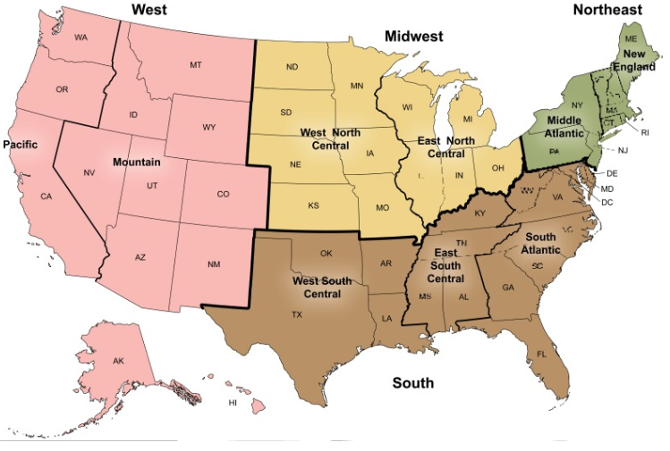
Cleaning The Data
Initial set: 4.1 million rows x 49 columns
TOO LARGE TO IMPORT!
Steps Taken To Clean Data:
Filter by year
Drop null and NA values
Layer in census divisions to further categorize data
Combine with driver counts by state to analyze further
Save by year and region for uploading and easier sampling
Image Source: https://www.ncbi.nlm.nih.gov/books/NBK551093/figure/appii.fig1/
Notes:
Sebastian

Slide 5
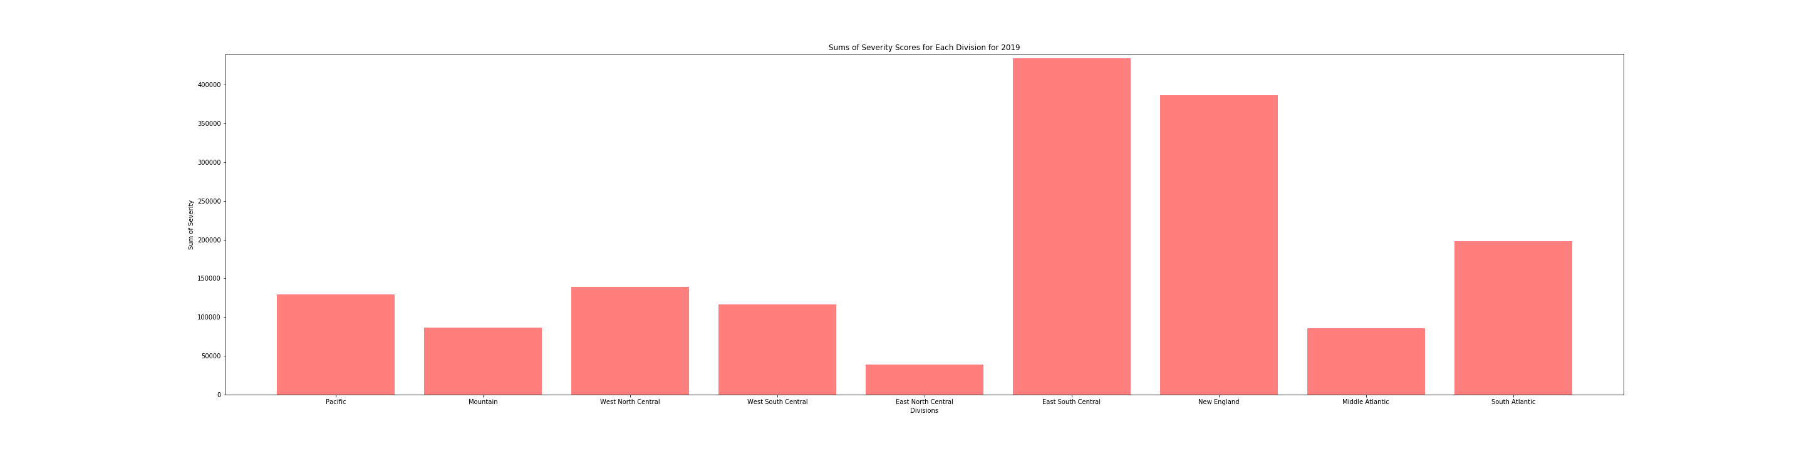






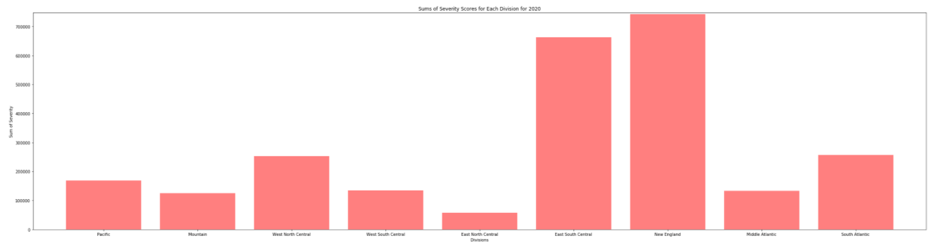
East South Central: Highest Total Severity
2019: East South Central Region had highest total severity score
2020: New England Region had highest total severity score
Notes:
Viz 1: Eddie

Slide 6
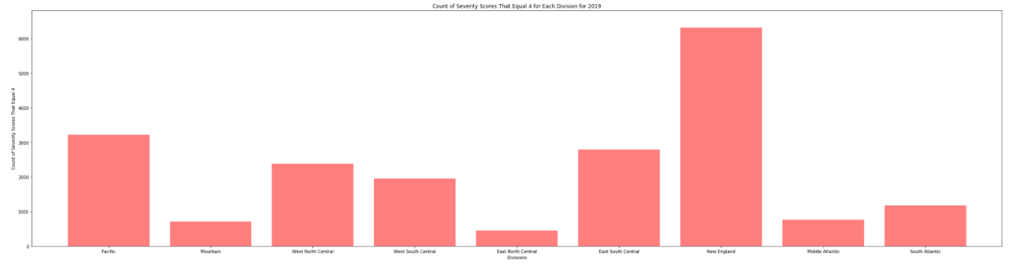
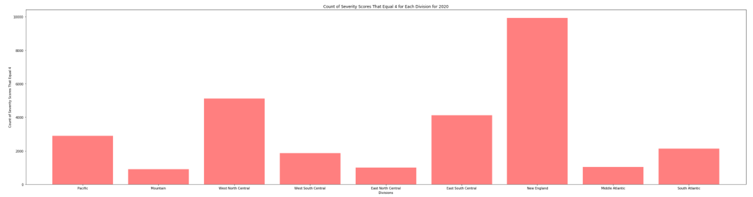
Severe Accidents Tell A Different Story
New England:
5% of Drivers, 30% of severe accidents
Notes:
Viz 2: Habiba
New England: 5% of total drivers, 31% of highest severity accidents by drivers

Slide 7
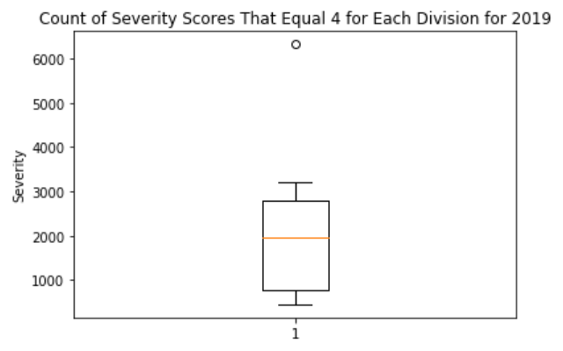
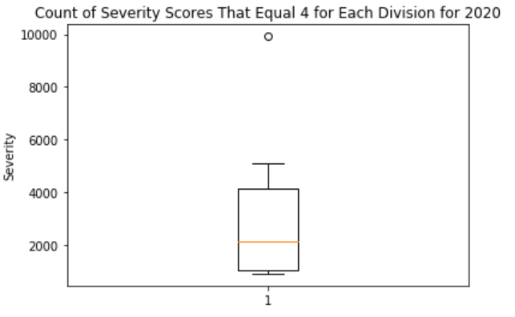
New England Increased in 2020 despite COVID
2020: Despite COVID, New England INCREASED number of severe accidents
Notes:
Viz 3: Sebastian

Slide 8
Topics For Further Study
Correlations with accident severity:
r=0.69
r=0.73
r=-0.21
OLDER DRIVERS (80+)
YOUNGER DRIVERS (UNDER 25)
PRECIPITATION AMOUNT
More time with the dataset will allow us to:
Expand number of years included in analysis
Utilize APIs to get up to date traffic data
Useful for:
Accident Prediction
Identifying problematic roads (driver avoidance AND municipal improvement recommendations)
Notes:
Eddie

